Slide 1
Introduction TP classes
1. Data types. Arithmetic expressions. Input and output
Catarina Carvalho
ccarvalho@fe.up.pt

Slide 2
The plan…
Short explanation of some key concepts
Definition of goals for class (which exercises are recommended to be solved during class and until next class)
Potential questions that can be asked during upcoming class

Slide 3
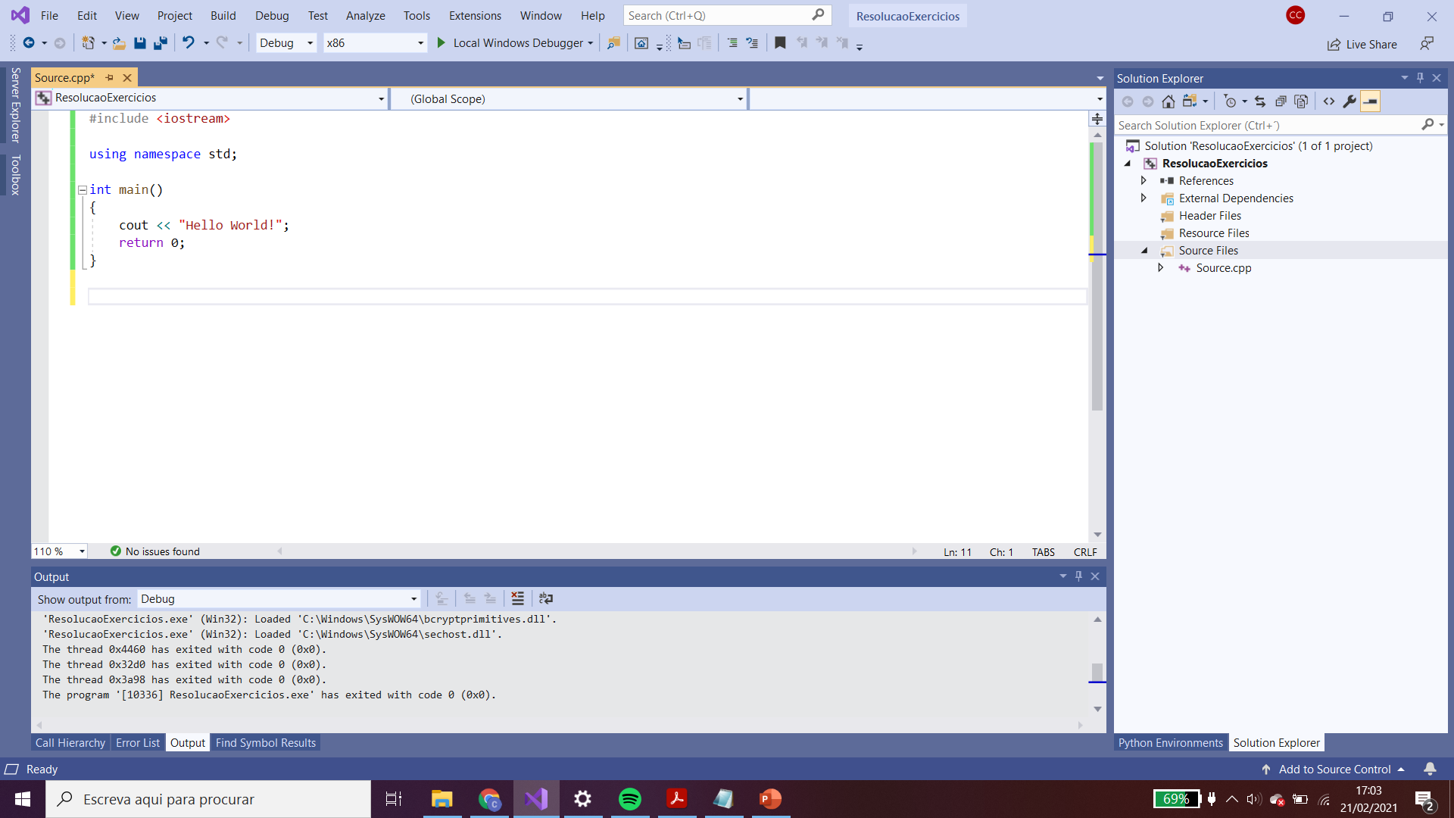
Hello World

Slide 4
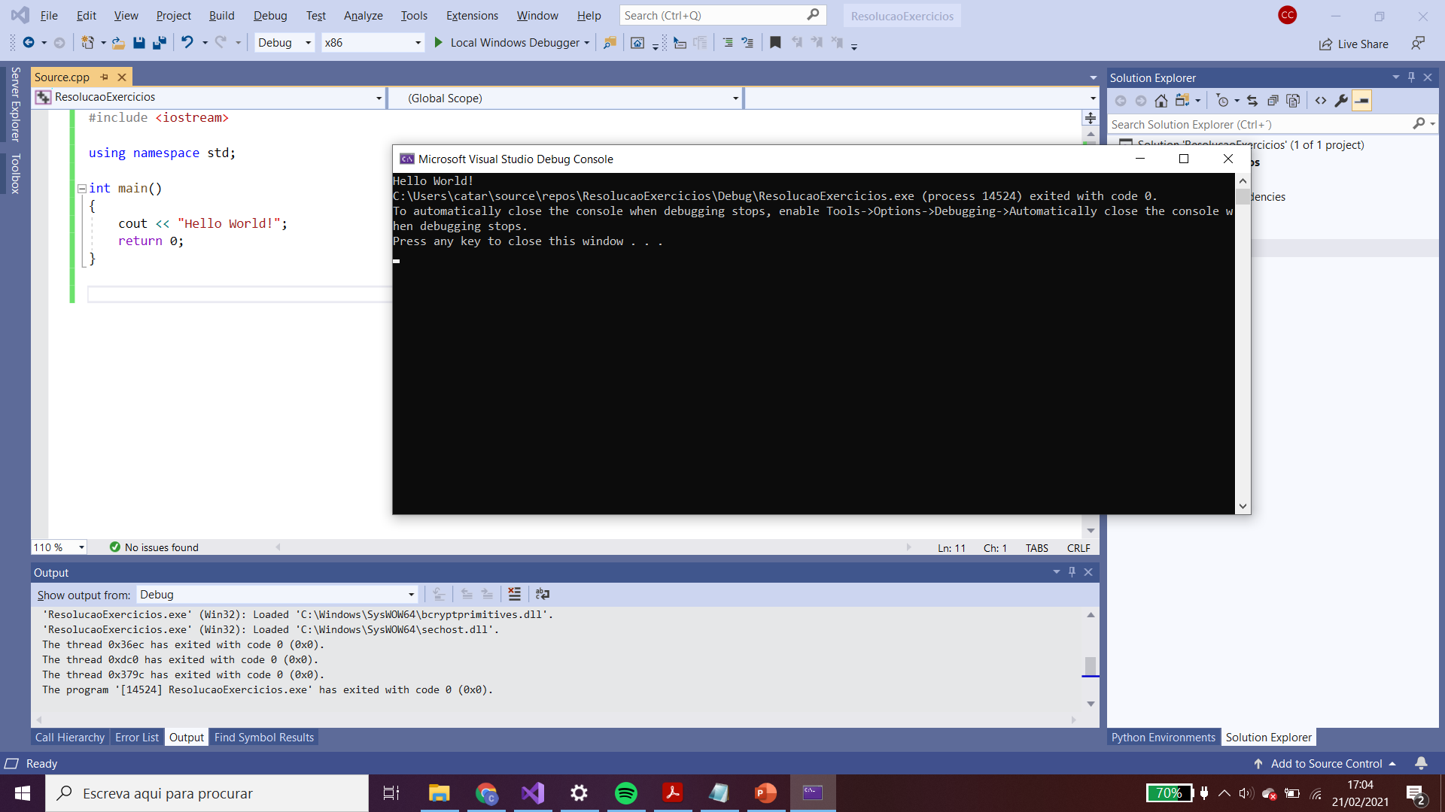
Hello World

Slide 5
Hello World
#include <iostream> => definition for the stream input/output package

Slide 6
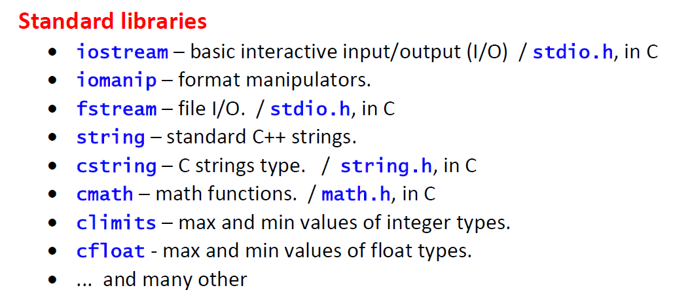
Hello World
#include <iostream> => definition for the stream input/output package

Slide 7
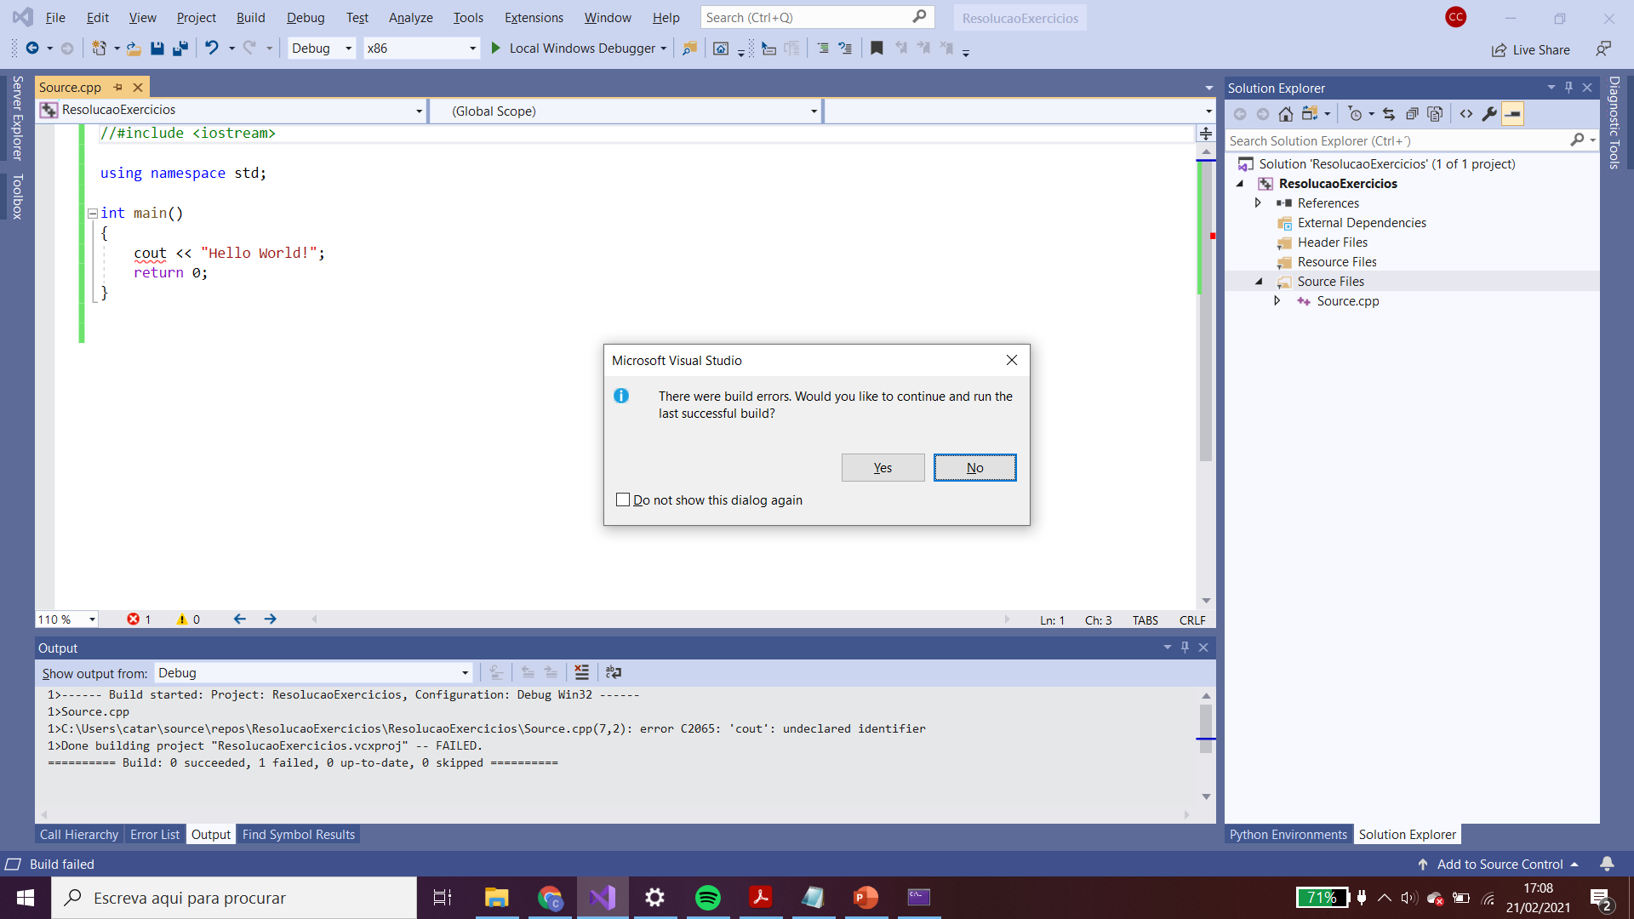
Hello World
#include <iostream> => definition for the stream input/output package

Slide 8
Hello World
Locate names in the “standard name space”

Slide 9
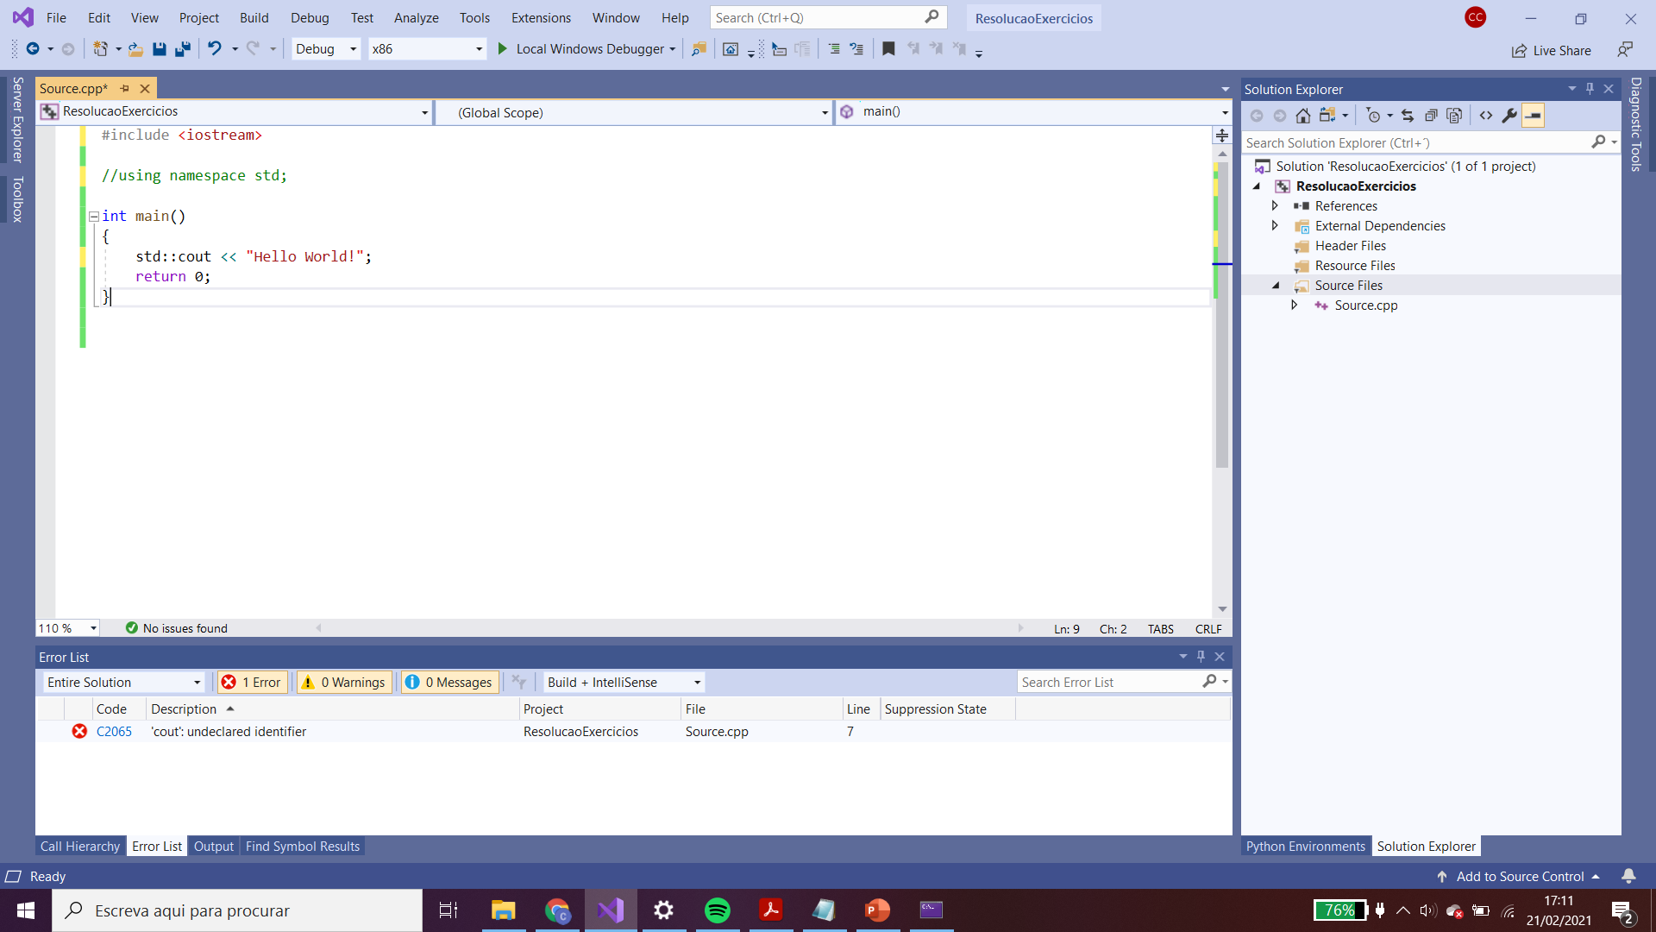
Hello World
Locate names in the “standard name space”
std::cout

Slide 10
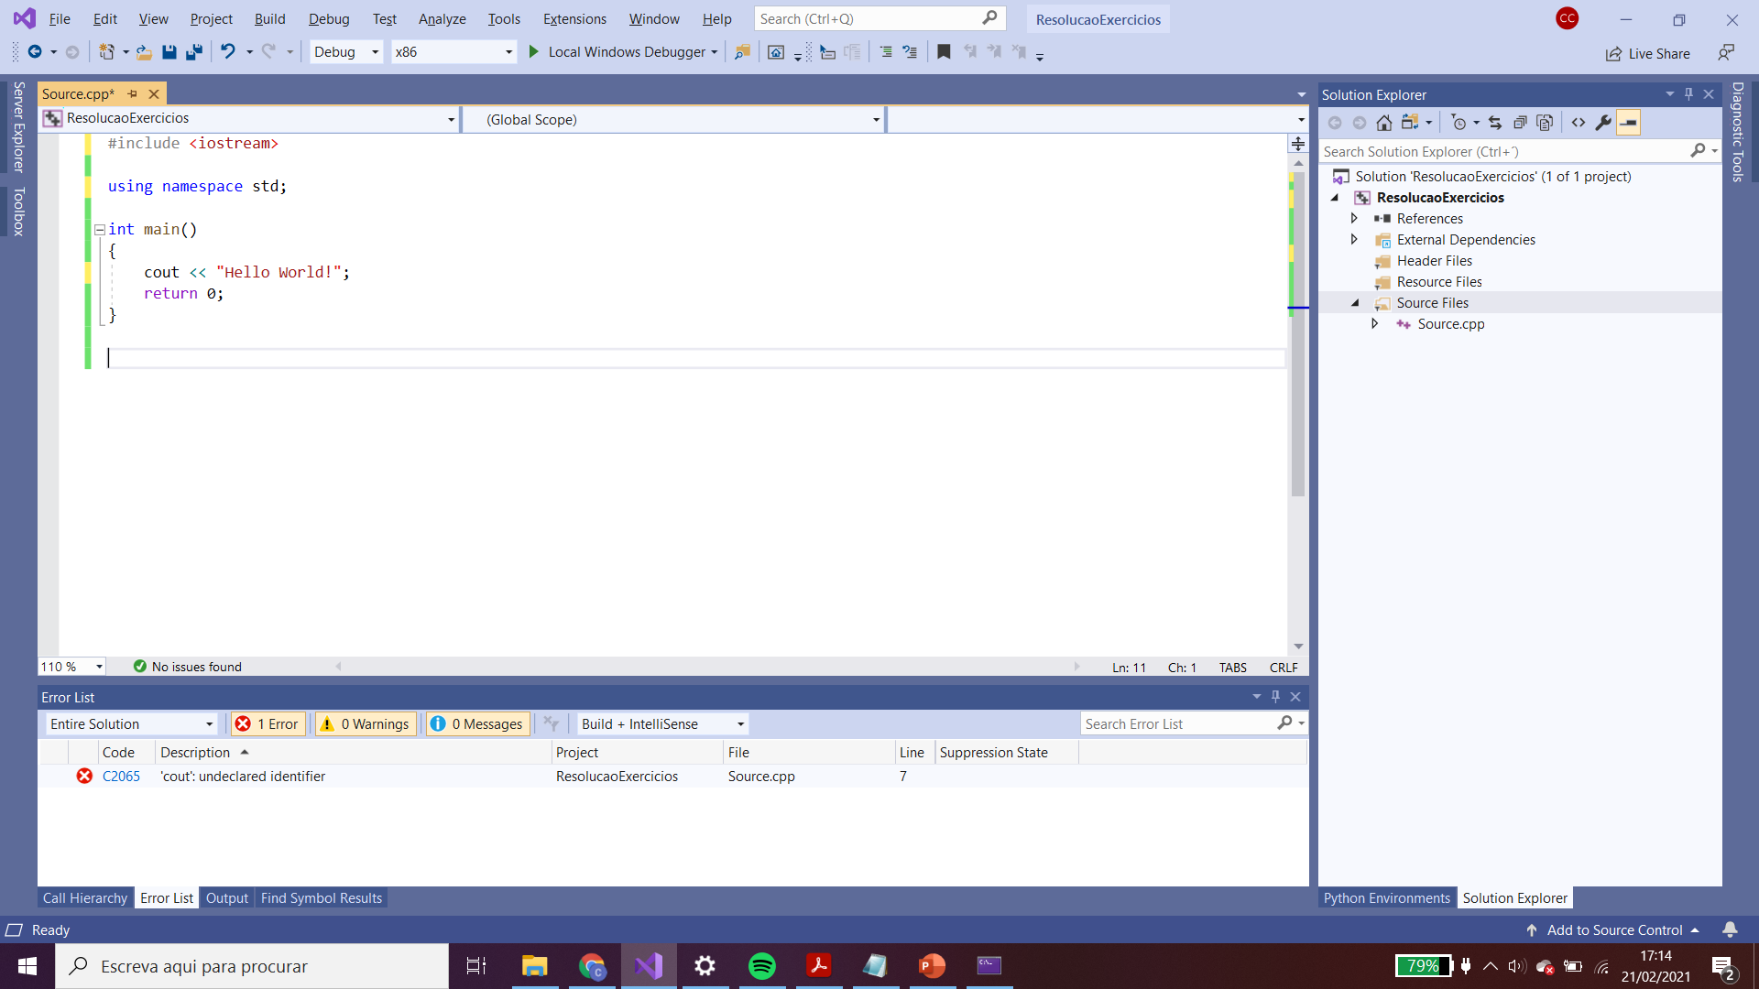
Hello World
Definition of main function
Function is a collection of programming instructions that carry out a particular task
Every C++ program MUST have a main function

Slide 11
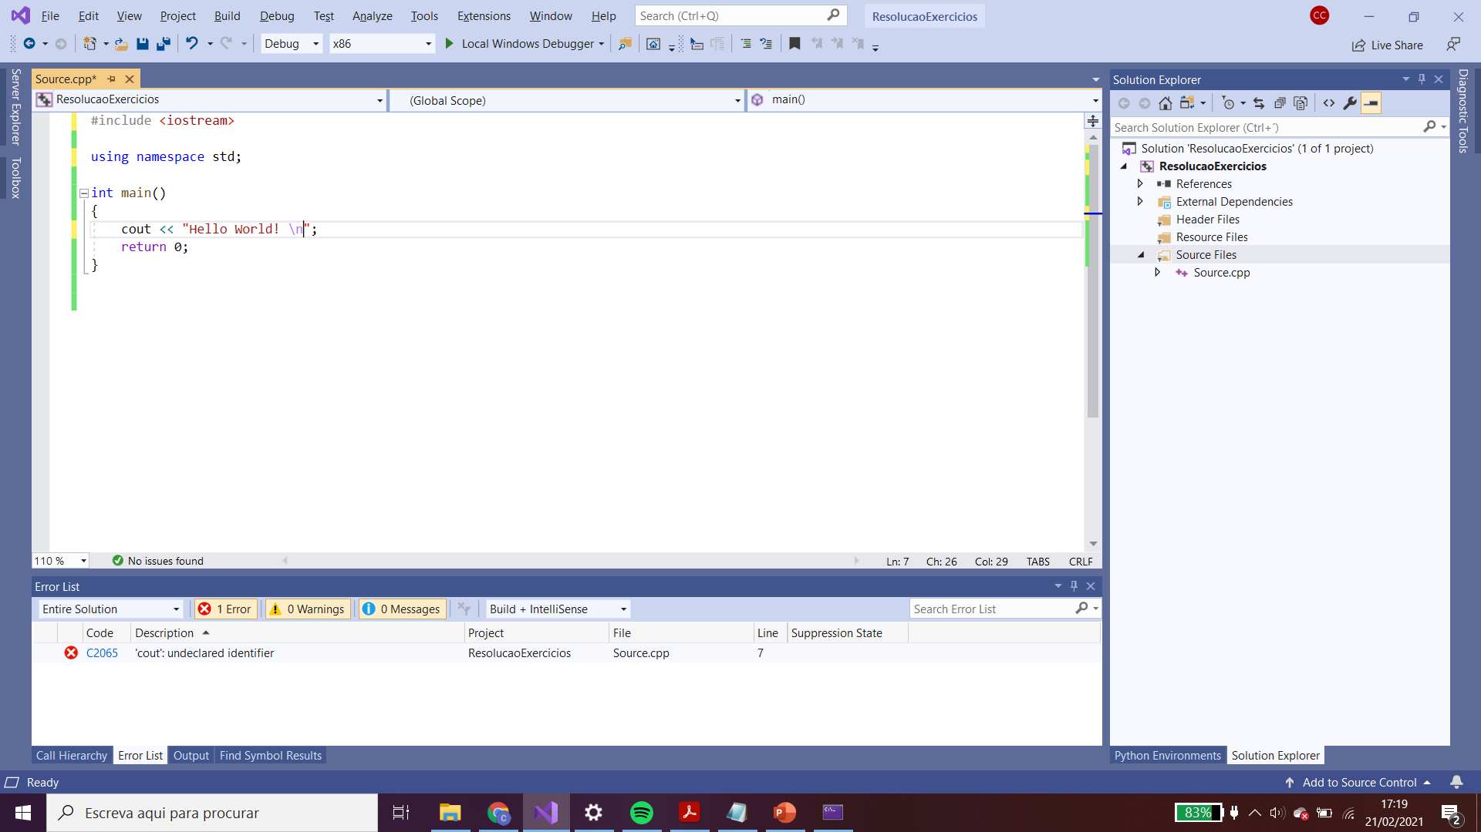
Hello World
Every statements MUST end in ;
\n => moves the cursor to a new line
The << operator denotes the “send to” command.
cout << 3+2 => displays 5

Slide 12
Common errors
Omitting semicolons – compiler uses ; to know the end of statements. If there are no ;, then the statement continues.
Ex: cout << “Hello World! \n” return 0; => Error
Confusion with:
std names… cot vs cout
Escape characters cout << “Hello world! \”;
Run-time error or logic error
The program is syntatically correct and does something

Slide 13
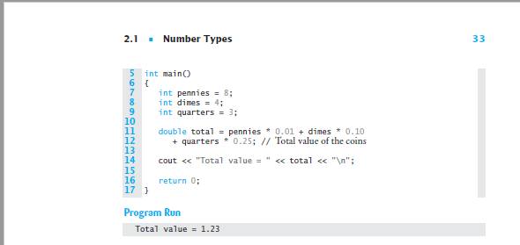
Identifiers and Keywords

Slide 14
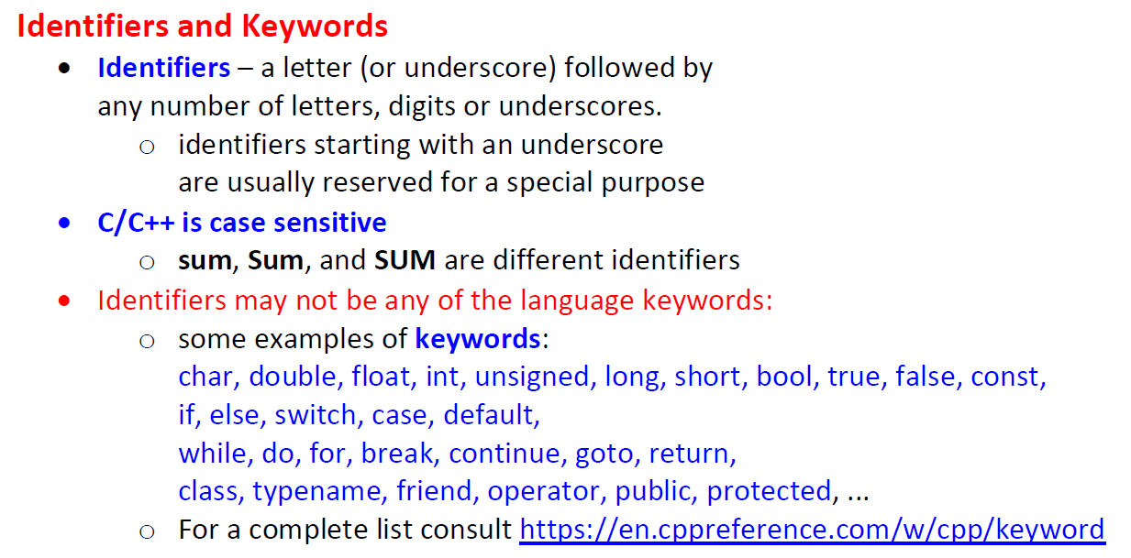
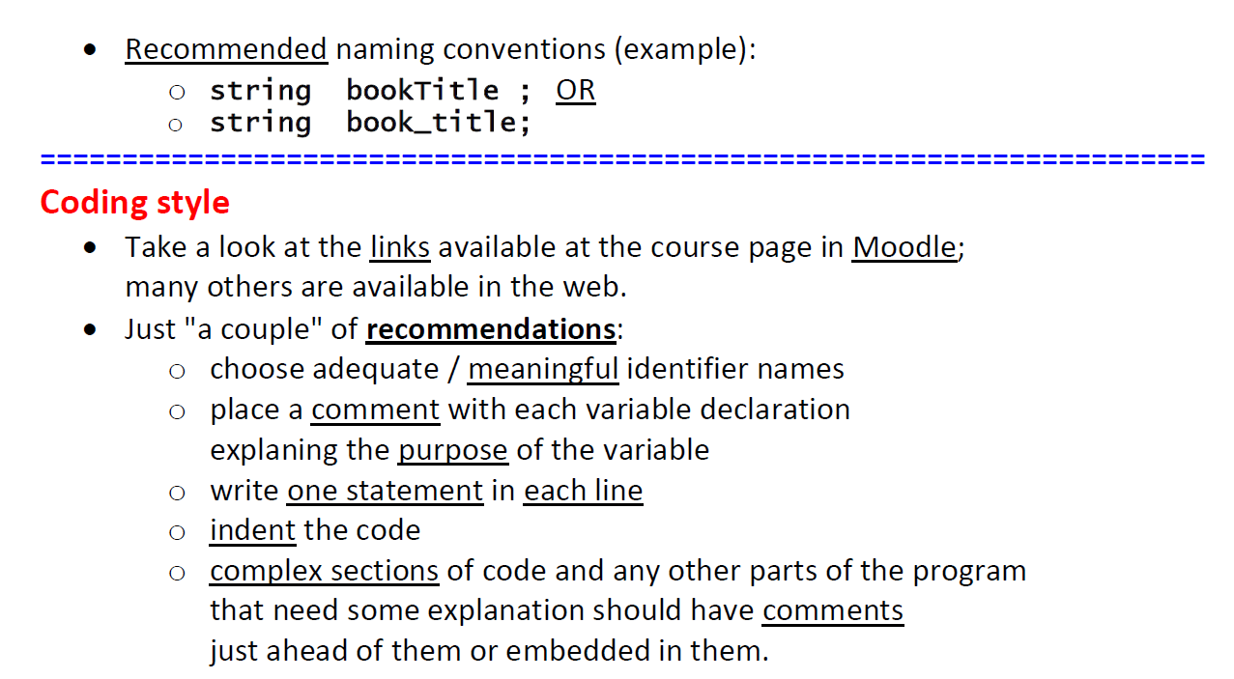
Identifiers and Keywords

Slide 15
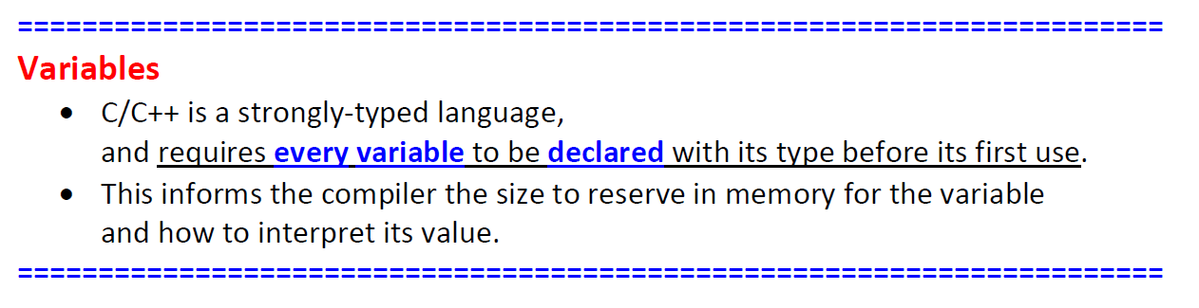
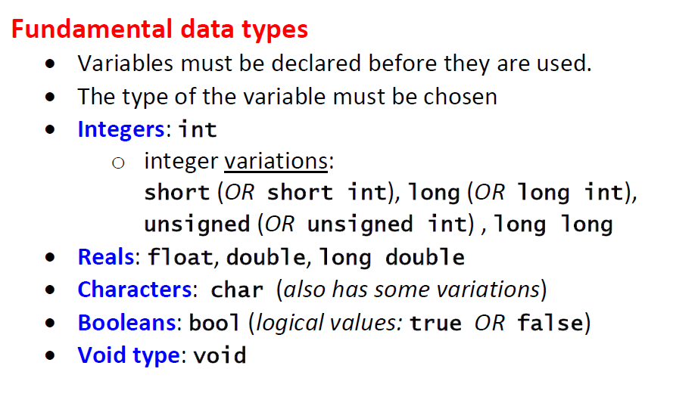
Identifiers and Keywords

Slide 16
Exercises
Exercise 1.1 => 1.6
(until next week)
Possible questions:
In exercise 1.1, which is the ASCII code of H
In exercise 1.2, which type of variables did you try? What did you find?
In exercise 1.3, how did you define the const? And how did you compute the r³
In exercise 1.4, which variable type did you choose for x and y?
In exercise 1.5, which was the rationalle for solving the exercise?
In exercise 1,6, how did you confirm the correctness of the solution?

